Slide 2
Modernizing .NET Desktop Applications with .NET Core
Olia Gavrysh
@oliagavrysh

Slide 3
Upgrades for Windows desktop development
modern libraries
modern look
analytics
good performance
integration with modern devices
diagnostics
new language features
leveraging modern platform’s features
deployment and distribution

Slide 4
Upgrades for Windows desktop development
modern libraries
With .NET Core 3.0
good performance
Talks:
This talk
Modernizing .NET Applications with .NET Core - Beyond the Basics - Mike Rousos
Day #3 12:00 (PDT) | 19:00 (UTC)
new language features

Slide 5
Upgrades for Windows desktop development
modern look
XAML Tools, XAML Islands
integration with modern devices
Talk:
Tour what’s new for XAML tools & Xaml Islands in Visual Studio 2019 - Dmitry Lyalin
Day #2 16:00 (PDT) | 23:00 (UTC)
leveraging modern platform’s features

Slide 6
Upgrades for Windows desktop development
analytics
DevOps, MSIX, App Center
diagnostics
Talk:
Get Started with DevOps for .NET Windows Desktop Apps and Visual Studio App Center - Daniel Jacobson Matt Korwel
Day #1 12:00 (PDT) | 19:00 (UTC)
deployment and distribution

Slide 7

Agenda
Why should you care about .NET Core for desktop
.NET Core or .NET Framework for my app
Porting to .NET Core
Fixing porting issues
Tolling for desktop on .NET Core
WinForms designer Preview 1

Slide 8
Why should you care about .NET Core for desktop

Slide 9
Why .NET Core for desktop
.NET Core is the future for .NET
.NET Core-specific features
Side-by-side deployment of different .NET Core versions
Self-contained applications
Single-file executables
Smaller app sizes
…and many more

Slide 10
How to choose: .NET Framework or .NET Core?
New apps
.NET Core
Completed apps in maintenance
OK to leave on .NET Framework
Existing apps in active development
Consider porting to .NET Core

Slide 11
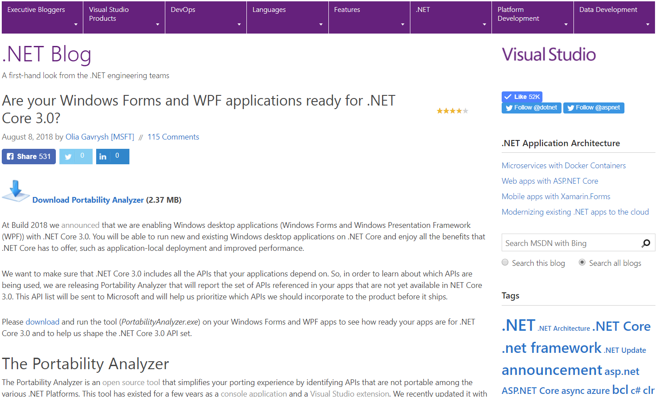
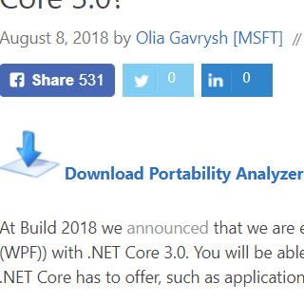
How compatible is my app with .NET Core?
Portability Analyzer
will show all APIs from your code that are not in .NET Core 3.0
https://aka.ms/portabilityAnalyzer

Slide 12
Demo: Portability Analyzer

Slide 13

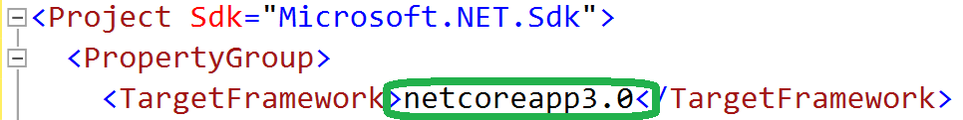
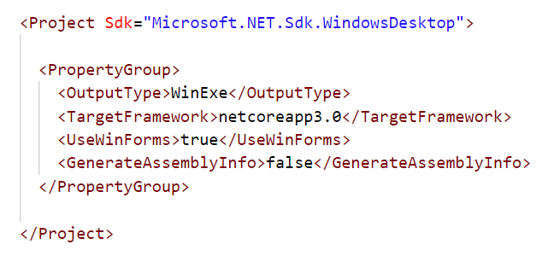
Porting
Porting to .NET Core\Standard is done by updating
If your .csproj file has old style, first migrate it to the new SDK-style

Slide 14
Porting by hand
If you have packages.config, right-click & “Migrate packages.config to PackageReference”
Update content of .csproj file with a .csproj file from blank .NET Core project
Add the references and resources from the old .csproj file:
<PackageReference>
<ProjectReference>
<Content>, <Resource>,…

Slide 15
Porting with Try Convert
Run from command line:
.\try-convert.exe -p “<path to your .csproj file>"

Slide 16
Demo: Try Convert

Slide 17
Windows Compatibility Pack
NuGet package Microsoft.Windows.Compatibility
Can be referenced from .NET Core & .NET Standard
Has ~21k APIs (Windows-only as well as cross-platform)
Contents
ACLs
Code Pages
CodeDom
Configuration
Crypto
DirectoryServices
EventLog
MEF
Odbc
Perf Counters
Permissions
…
Ports
Registry
Runtime Caching
WCF
Windows Services

Slide 18
Demo: XAML Designer for .NET Core

Slide 19
WinForms Designer Preview 1
https://aka.ms/winforms-designer
Common controls and base operations
Further monthly previews
Too early to port if you use designer a lot
Give us your feedback via Visual Studio feedback channel

Slide 20
Demo: WinForms Designer for .NET Core

Slide 21
Thank you!
Olia Gavrysh
twitter: @oliagavrysh

